Slide 1
CI/CD PIPELINE WITH JENKINS
A CI/CD pipeline refers to a set of automated processes used to build, test, and deploy software applications in an efficient and consistent manner.
CI/CD stands for Continuous Integration and Continuous Deployment/Delivery.
The continuous integration/continuous delivery (CI/CD) pipeline is an automated DevOps workflow that streamlines the software delivery process.
CI/CD helps organizations avoid bugs and code failures while maintaining a continuous cycle of software development and updates.

Slide 2
Continuous Integration (CI):-
Automated Builds Whenever code is committed to the version control system (e.g., Git), an automated process triggers a build to compile the code and run unit tests.
Automated Testing Running automated tests ensures that new code doesn't break the existing functionality of the application.
Continuous Delivery/Deployment (CD):-
Continuous Delivery (CD) means the code is always in a deployable state, but the deployment itself may require a manual approval or a scheduled trigger. This ensures that new features and fixes can be released quickly and reliably, but the actual deployment happens at a controlled time.
It is a step further where every change that passes the automated tests is automatically deployed to production without any manual intervention. This allows for frequent releases of new features or bug fixes.

Slide 3
Benefits of CI/CD
Faster Delivery Automation of testing and deployment means new features and fixes can be shipped more quickly.
Improved Code Quality Automated tests catch errors early, reducing bugs in production.
Consistency Automated processes ensure that the software is built, tested, and deployed in a consistent manner.
Reduced Risk By integrating and testing frequently, changes are smaller and easier to debug, reducing the risk of large-scale issues.

Slide 4
Tools commonly used for CI/CD include:
CI tools: Jenkins, GitLab CI, CircleCI, Travis CI
CD tools: Kubernetes, Docker, Argo CD, Spinnaker
Here we use Jenkins to deploy the application with the required installations.
Tools that are used to install and deploy the application are:-
Jenkins
Java
Maven
Trivy
Docker
Docker-Compose
OWASP Dependency

Slide 5
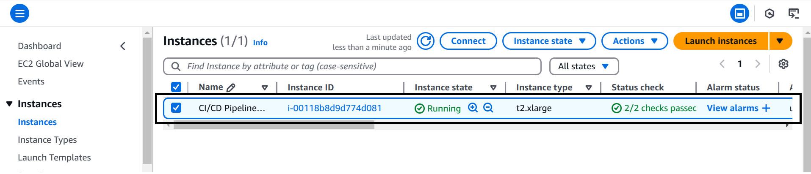
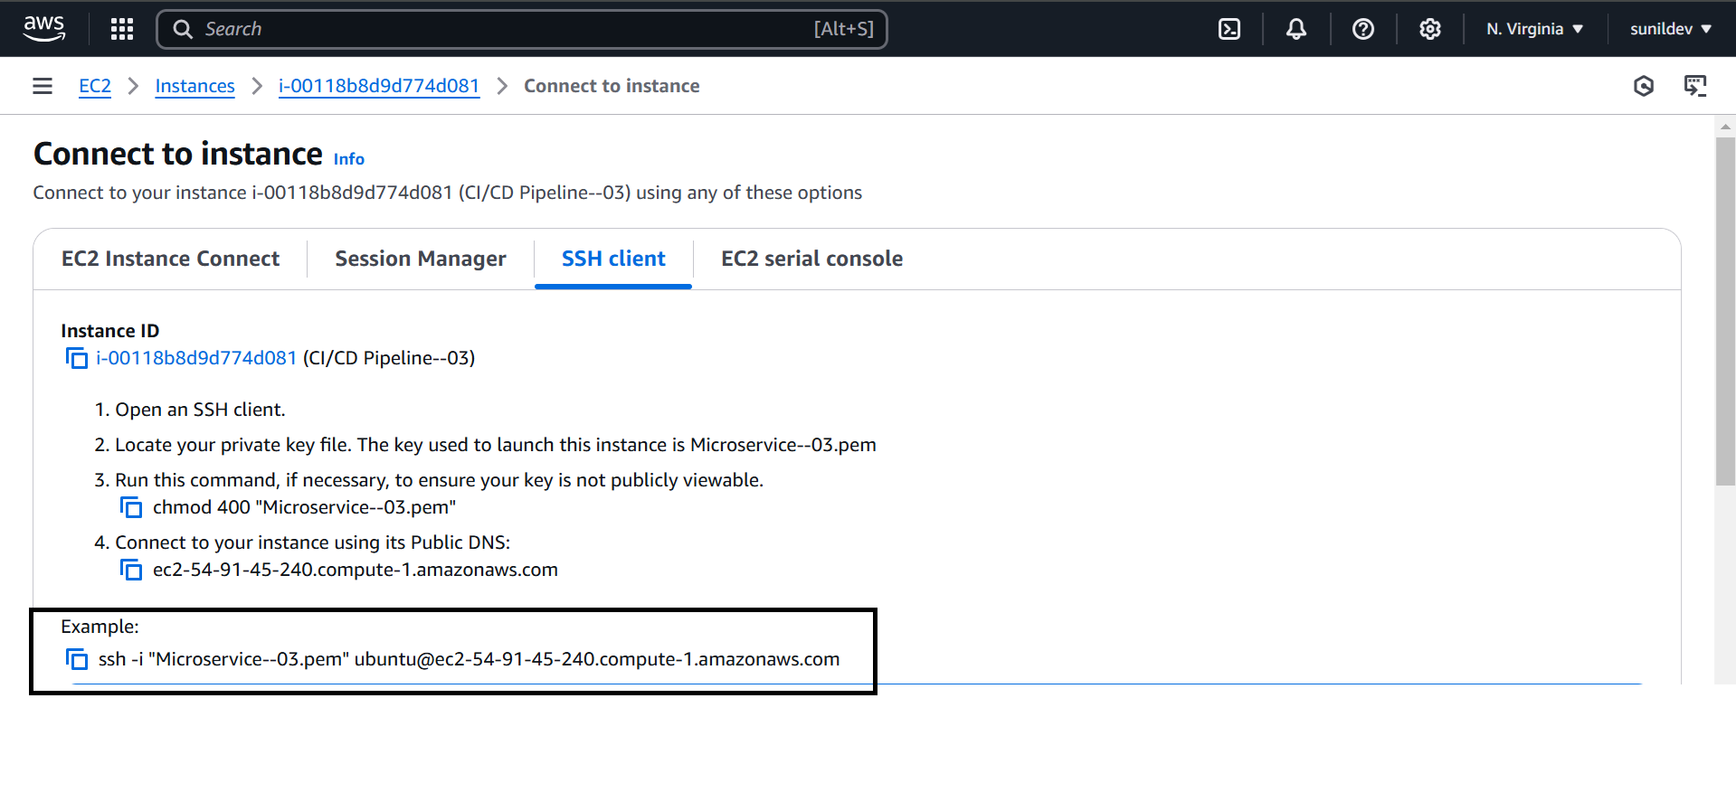
Create an instance in AWS Console take Ubuntu and instance type is t2-large
Now Connect the instance to gitbash with SSH client link

Slide 6
Now install the necessary installations in gitbash
Firstly we need to install the Jenkins and Java to connect with the Jenkins Dashboard
sudo wget -O /etc/yum.repos.d/jenkins.repo https://pkg.jenkins.io/redhat-stable/jenkins.repo
sudo rpm --import https://pkg.jenkins.io/redhat-stable/jenkins.io-2023.key
yum install fontconfig java-17-openjdk
yum install jenkins
To install Java:
Sudo dnf update -y
Yum list java*
Sudo dnf install- y java-17-amazon-corretto.x86_64

Slide 7
After installing Jenkins and java we need to restart the Jenkins server to access the Jenkins dashboard
systemctl restart jenkins.service
systemctl status jenkins.service
After restarting the Jenkins copy the public IP address and paste the IP in google with Jenkins port number 8080 to access the Jenkins dashboard
Add the required details like
Username
Password
E-mail
And press the continue button to access the dashboard
Then Jenkins dashboard will be opened and open the manage Jenkins and install the necessary plug-in in it

Slide 8
Trivy Installations:
sudo apt-get update
sudo apt-get install -y wget
wget https://github.com/aquasecurity/trivy/releases/download/v0.29.2/trivy_0.29.2_Linux-x86_64.deb
sudo dpkg -i trivy_0.29.2_Linux-x86_64.deb
Docker Installations:-
sudo apt-get update
sudo apt-get install -y apt-transport-https ca-certificates curl software-properties-common
curl -fsSL https://download.docker.com/linux/ubuntu/gpg | sudo apt-key add -

Slide 9
sudo add-apt-repository "deb [arch=amd64] https://download.docker.com/linux/ubuntu $(lsb_release -cs) stable"
sudo apt-get update
sudo apt-get install -y docker-ce
sudo docker --version
sudo systemctl enable docker
sudo usermod -aG docker $USER

Slide 10
Then Jenkins dashboard will be opened and open the manage Jenkins and install the necessary plug-ins in it
Pipeline Stage view
SonarQube
Docker
Gradle Plugin
Java
OWASP Dependency check-plugin
These plugins are used to deploy the application with required requirements
Now add the required Tools in init

Slide 11
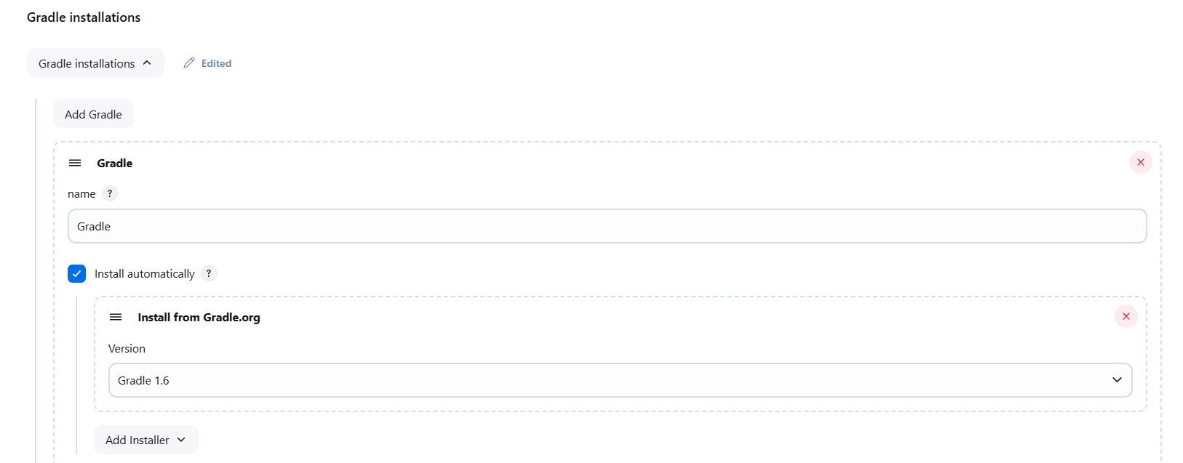
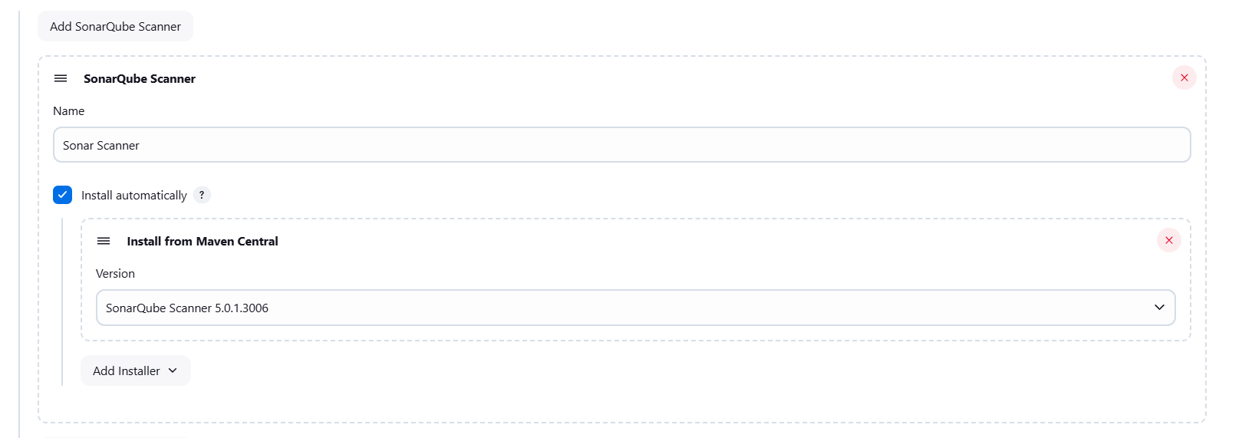
Now add the required Tools in init
Add Gradle installation
Add SonarQube Scanner

Slide 12
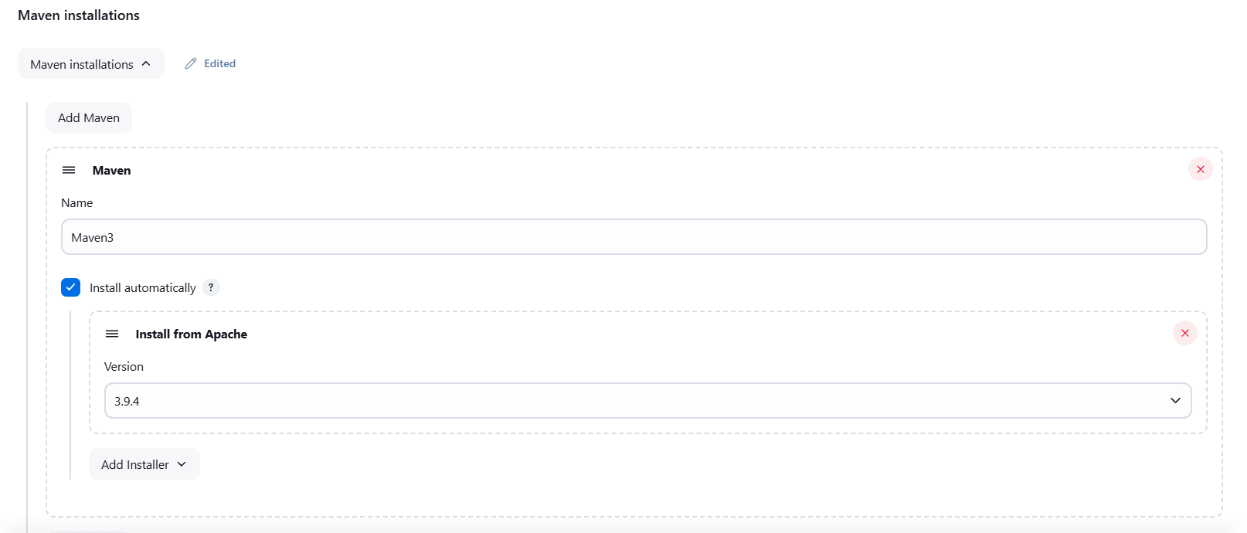
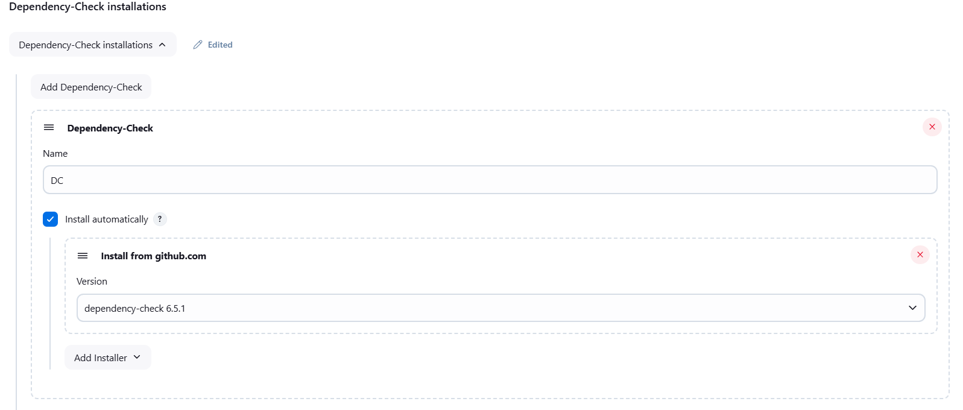
Add Maven Version
Add Dependency Check

Slide 13
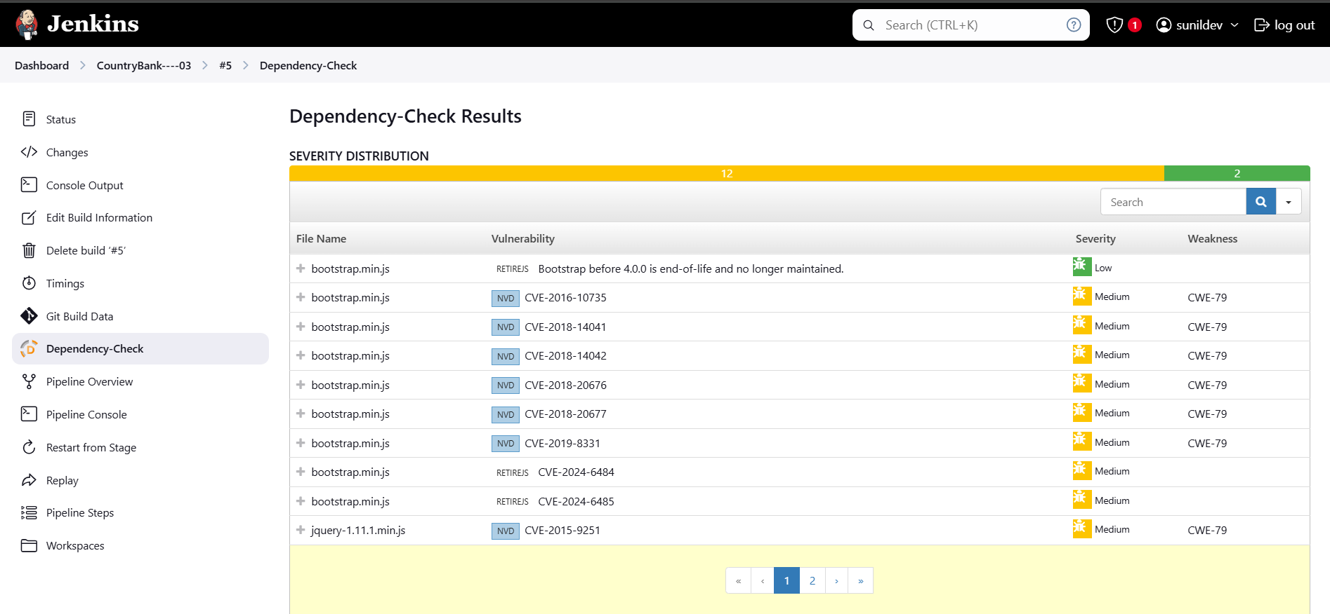

Slide 14
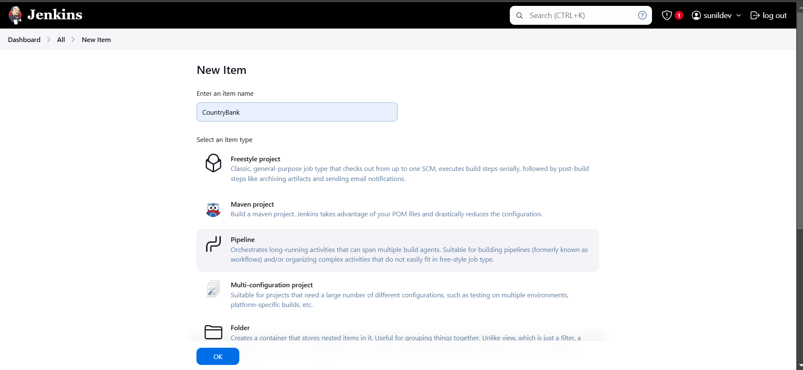
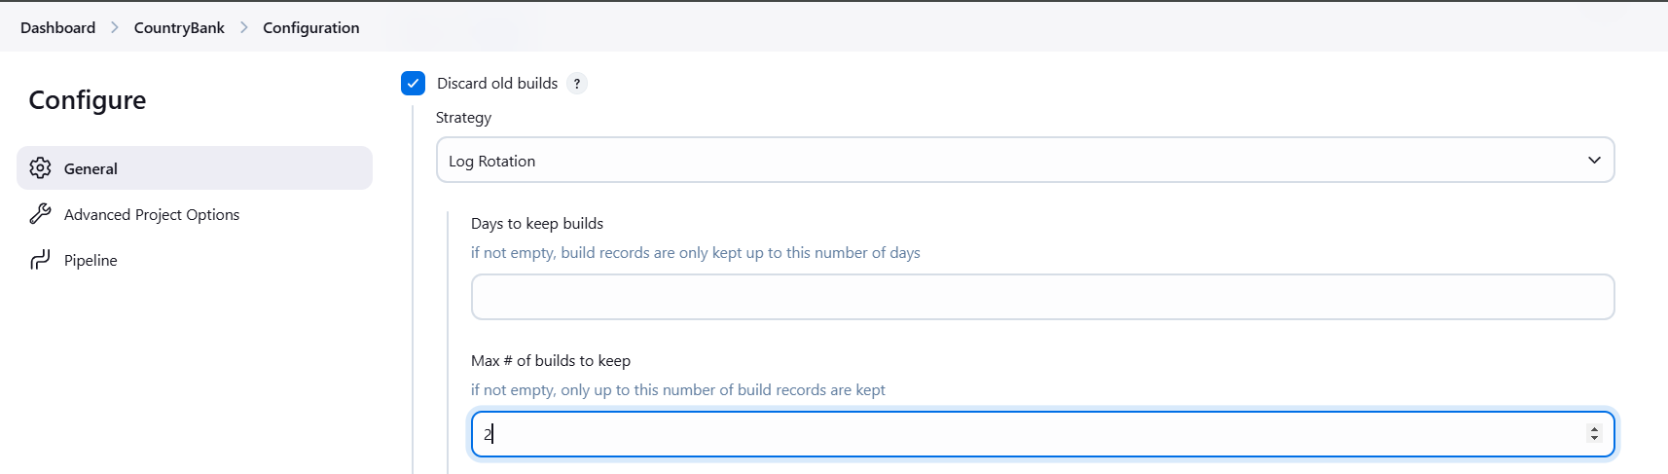
Take New item in Jenkins dashboard and enter the item name and select the pipeline and click OK
Here enable the discard old builds and give the maximum builds of 2

Slide 15
In pipeline script add the required pipeline and add the stages we required like
Git checkout
OWASP Dependency
Trivy
Build & Deploy
These stages are used to run the pipeline and deploy the application
And we have to add the necessary steps under the stages like git repository, dependency check and docker-compose before the pipeline build

Slide 16
Pipeline:-
pipeline {
agent any
stages {
stage('Git Checkout') {
steps {
git https://github.com/sunildev03/CountryBank--03.git'
}
}
stage('OWASP Dependency Check') {
steps {
dependencyCheck additionalArguments: ' --scan ./ ', odcInstallation: 'DC'
dependencyCheckPublisher pattern: '**/dependency-check-report.xml'
}
}

Slide 17
stage('Trivy') {
steps {
sh "trivy fs ."
}
}
stage('Build & deploy') {
steps {
sh "docker-compose up -d"
}
}
}
}

Slide 18
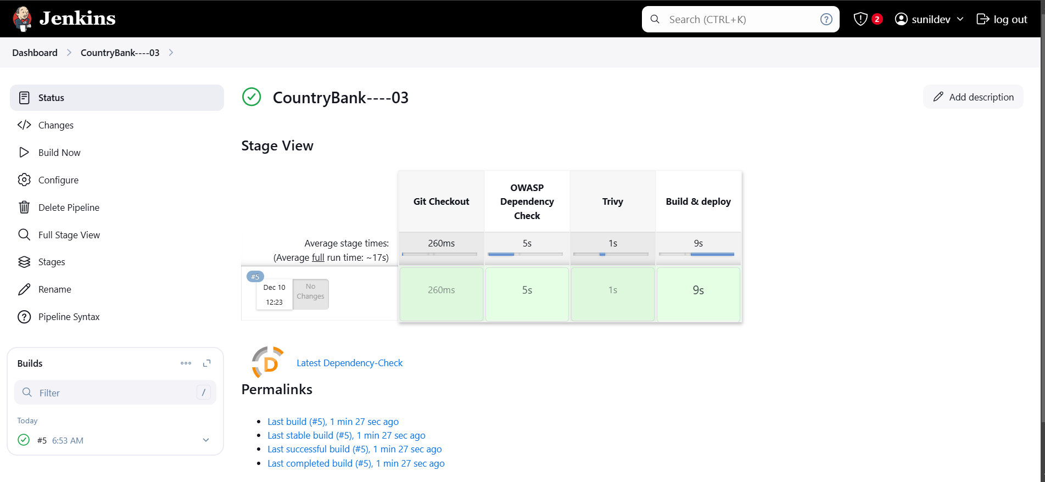
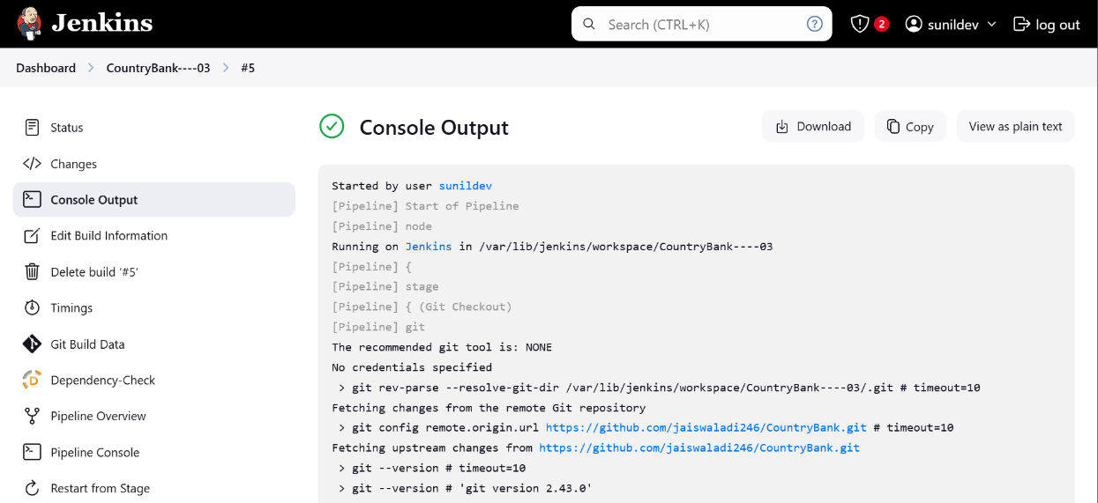
Now save and apply the pipeline and run the build After build got success the stage view will be looks like below Stage View:
Now save and apply the pipeline and run the build
After build got success the stage view will be looks like below
Stage View:

Slide 19
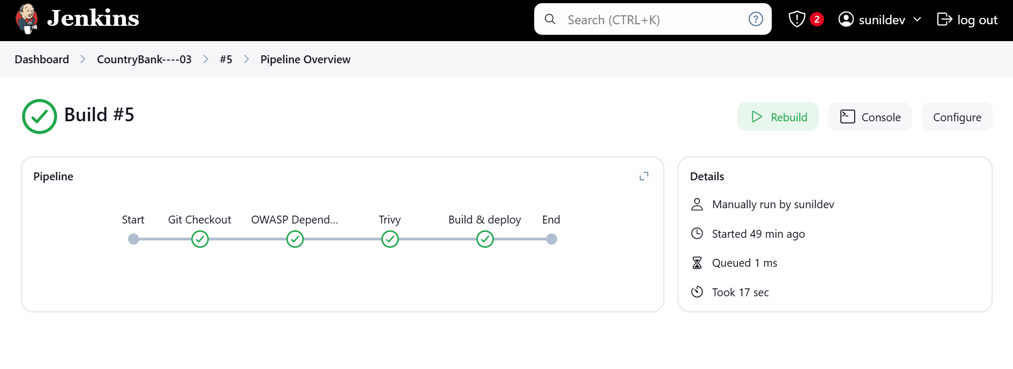
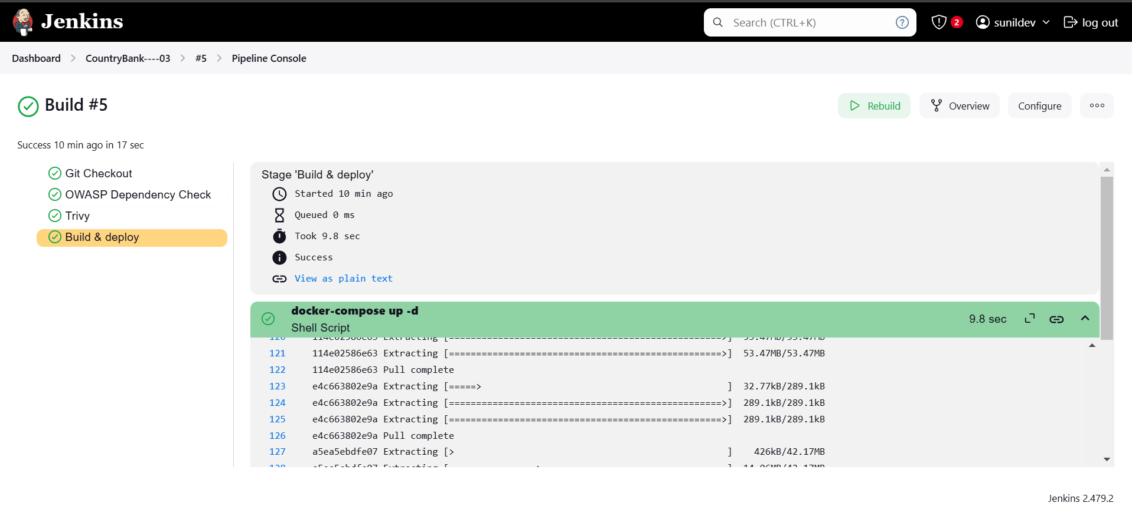

Slide 20


After the build success now again copy the Public IP of the instance and copy it in the google with the port number 8000 to access the application then application will be opened like below

